Slide 1
Subjects and Verbs
Core of the Sentence

Slide 2
Typical English Word Order
Subject Verb Object
The boy hit the ball.
Doer Action done Action received

Slide 3
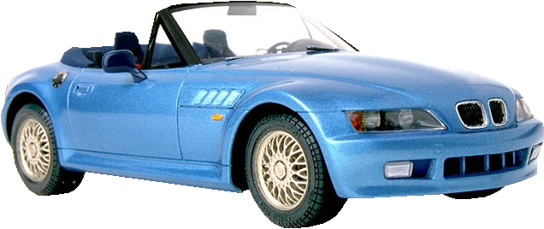
Subjects & Verbs Compare to a Car

Slide 4
Subjects
A subject is like the driver of a car

Slide 5
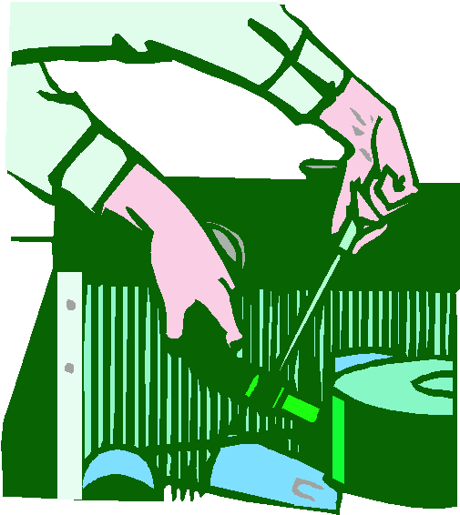
Verbs A verb is the motor of the sentence

Slide 6
Kinds of Verbs
1. Action Verbs – Things happen!
Joe jumped through the hoop.
Mary punched the professor.
The Dean suspended Mary.

Slide 7
Linking Verbs
2. Linking Verbs – pg 269 – memorize
- Forms of “to be” – is, am, are, was, were,
be, being, been
- Verbs of the senses: become, feel, look, seem
Think of linking verbs
as equals signs:
Mary is a student.
Mary = a student.

Slide 8
Helping Verbs
Pgs 271 in text – memorize
- Linking verbs formed from the infinitive “to be”: is, am, are, was, were, be, being, been
-Forms of: to do, to have, would, may, might, must, can, could, shall, should

Slide 9
Verb Phrases
These verbs used together form
COMPLETE VERBS
OR
VERB PHRASES
Example: We have been working on this project.
Pick out the verb phrase in the following sentence:
Example: You should have been working today.

